Slide 1
BLAZOR

Slide 2
Blazor, a platform for building modern UIs with C#
Blazor is a fully featured framework for building modern client-side applications using the power of C# and .NET. This allows developers to build engaging applications that work across nearly any platform, including web, mobile, and desktop.
Blazor is an alternative to JavaScript frameworks and libraries such as Angular, Vue.js, and React. If you’ve had experience working with any of these, then you’ll probably start spotting familiar concepts. The most notable influence is the ability to build UIs with components, a concept all these technologies share and something we’ll explore in more detail later in this chapter.
Because Blazor is built on top of web standards, it doesn’t require the end user to have .NET installed on their machines or any kind of browser plug-in or extension. In fact, with Blazor WebAssembly applications, we don’t even need .NET running on the server; this flavor of Blazor can be hosted as simple static files.

Slide 3
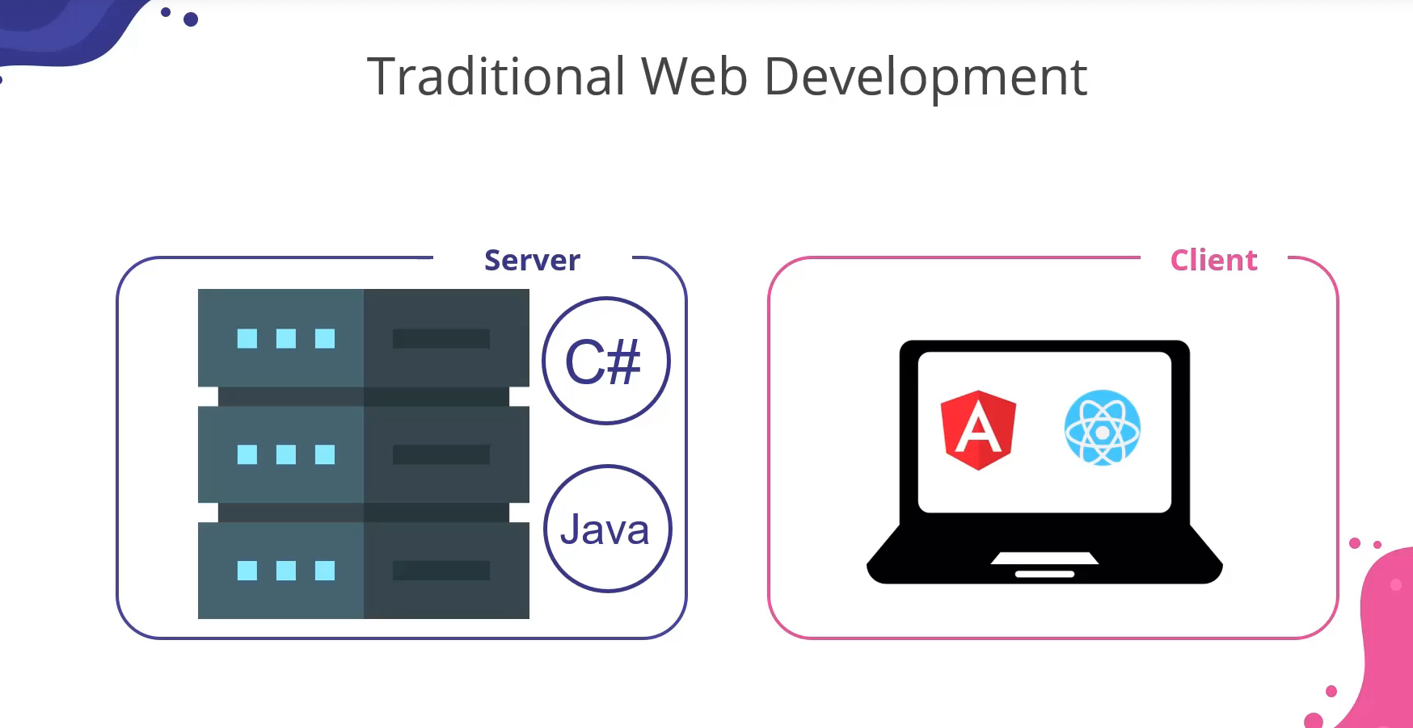
Traditional Web Development

Slide 4
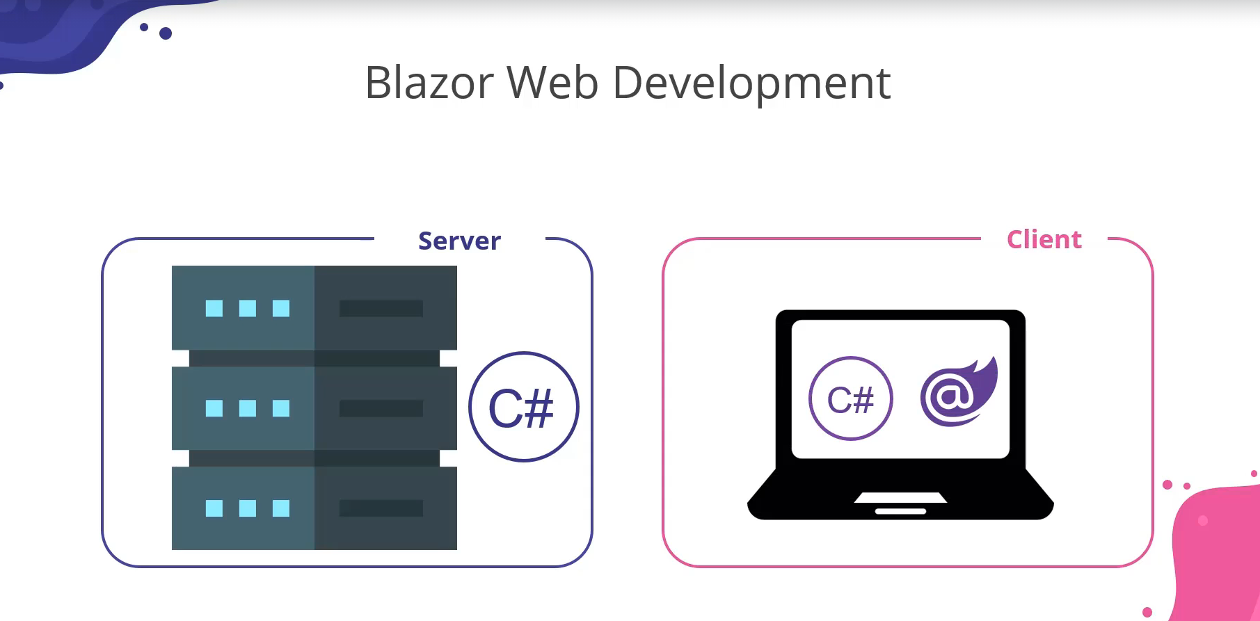
Blazor Web Development

Slide 5
But why Blazor
C#, a modern and feature-rich language—Blazor is powered by C#, the eighth most popular language, according to the 2021 Stack Overflow Developer Survey (http://mng.bz/p240). It’s powerful, easy to learn, and versatile. While C# is an object-oriented language, it’s adopting more and more abilities to enable a more functional approach, if you prefer. Static typing helps developers catch errors at build time, making the development life cycle faster and more efficient. It’s also been around for a long time, currently in its tenth version. It’s stable, well designed, and well supported.
Great tooling—The .NET community has been fortunate to have some amazing tooling. Visual Studio is an extremely powerful, feature-rich, and extensible IDE (integrated development environment). It’s also 100% free for individuals, open source work, or non-enterprise teams of up to five people. If you prefer something more lightweight, then there is Visual Studio Code (VS Code), one of the most popular code editors today. Both Visual Studio and VS Code are available cross-platform. Visual Studio is available on Windows and macOS, and VS Code is available on Windows, macOS, and Linux. There is also a great third-party IDE by JetBrains called Rider, which is cross-platform running on Windows, macOS, and Linux.
.NET Ecosystem—While many new frameworks need to wait for an ecosystem to build up around them, Blazor can tap into the existing .NET ecosystem. At the time of writing, Blazor applications target .NET 6 and can, in theory, use any compatible NuGet package. I say “in theory,” as some packages perform actions that aren’t allowed in a WebAssembly scenario, such as modifying the filesystem.

Slide 6
Unopinionated—While other frameworks stipulate how applications must be written, Blazor does not. There are no preferred patterns or practices for Blazor development; you can write applications using the ones you’re familiar and comfortable with. If you like MVVM (model-view-viewmodel), go for it. If you prefer using Redux, have at it. The choice is yours.
Shallow learning curve—If you’re an existing .NET developer, then the learning curve for Blazor is quite shallow. Razor, C#, dependency injection, and project structure will all look familiar to you, and with Blazor being unopinionated around patterns, you can just use what you’re familiar and productive with. All this means you can focus on writing features more quickly, rather than learning the framework.
Code sharing—If you’re using C# on the server, then Blazor makes an excellent pairing. One of the most frustrating problems with different client and server languages is the inability to reuse code. Models or data transfer objects (DTOs) must be duplicated between server and client; they need to be kept updated, in sync. This could be a manual process or automated using some kind of code generation, but this is just another thing to set up and maintain. With Blazor, everything is C#. Any shared code can be placed in a common .NET class library and shared easily between server and client.
Open source—As with many projects at Microsoft, Blazor is fully open source and the code is freely available on GitHub for you to browse, download, or fork your own copy. The team works in the open and is guided by developer requests and feedback. You can even contribute if you wish.

Slide 7
Understanding Hosting Models
When first getting started with Blazor, you will immediately come across hosting models. Essentially, hosting models are where a Blazor application is run. Currently, Blazor has two web-specific hosting models
Blazor WebAssembly
Blazor Server.
Regardless of which model you choose for your application, the component model is the same, meaning components are written the same way and can be interchanged between either hosting model (figure 1.4).

Slide 8
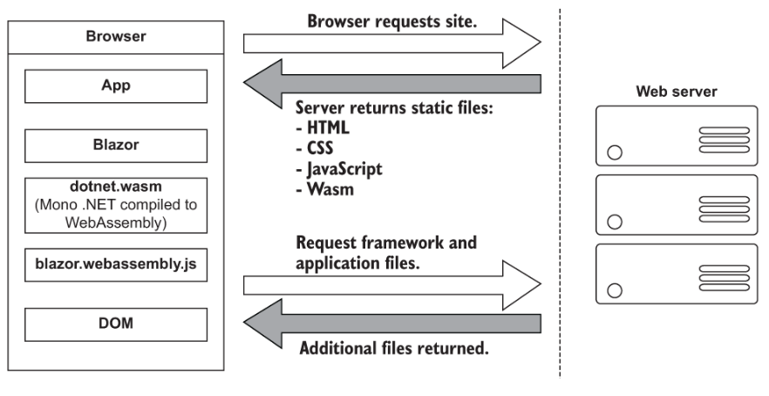
Blazor WebAssembly

Slide 9
How does this work
The process begins when a request is made by the browser to the web server. The web server will return a set of files needed to load the application. These include the host page for the application, usually called index.html; any static assets required by the application, such as images; CSS and JavaScript, as well as a special JavaScript file called blazor.webassembly.js.
In the Blazor WebAssembly hosting model, part of the Blazor framework resides in JavaScript and is contained in the blazor.webassembly.js file. This part of the framework does three main things:
Loads and initializes the Blazor application in the browser
Provides direct DOM (Document Object Model) manipulation so Blazor can perform UI updates
Provides APIs for JavaScript interop scenarios, which we’ll discuss in detail in later chapters
At this point, you may be wondering why we have a JavaScript file. One of the big selling points of Blazor is the ability to write UI logic using C# instead of JavaScript, right? Yes, that’s true. But as of right now, WebAssembly has a large limitation: it can’t alter the DOM or call Web APIs directly. These features are planned and being worked on for the next phase of WebAssembly, but until they land, JavaScript is the only way to perform these tasks.
It’s possible that in the future this file will no longer be required. This will depend on how fast features are added to WebAssembly and adopted by browsers. But for now, it’s an essential part of the framework.

Slide 10
Now that we’ve cleared that up, let’s get back to booting the Blazor app. I want to point out that the files returned from the server are all static files; they haven’t required any server-side compilation or manipulation. This means that they can be hosted on any service that offers static hosting. There is no requirement for a .NET run time to be present on the server. For the first time, this opens up free hosting options such as GitHub pages to .NET developers (this applies to standalone Blazor WebAssembly applications only).
Once the browser has received all the initial files from the web server, it can process them and construct the DOM. Next, blazor.webassembly.js is executed. This performs many actions, but in the context of starting a Blazor WebAssembly app, it downloads a file called blazor.boot.json. This file contains an inventory of all the framework and application files that are required to run the app. Once it’s downloaded, it is used to download the remaining files needed to run the application.
Most of these files are normal .NET assemblies; there is nothing special about them, and they could be run on any compatible .NET run time. But there’s also another type of file that is downloaded called dotnet.wasm. This file is a complete .NET run time that has been compiled to WebAssembly.
By default, only the .NET run time is compiled to WebAssembly—the framework and application files are standard .NET assemblies. However, in .NET 6, an AOT (ahead-of-time) mode was introduced that allows developers to compile their applications to WebAssembly. The benefit of this is much improved performance for CPU-intensive code. Using AOT, CPU-intensive code compiled to WebAssembly will be many times more performant than the interpreted approach used by default. However, there’s a tradeoff, and that’s size. AOT-compiled code is around two times bigger than the standard assemblies, meaning a much larger overall download size for the application.
Once the blazor.boot.json file has been downloaded and the files listed in it have been downloaded, it’s time for the application to be run. The WebAssembly .NET run time is initialized, which in turn loads the Blazor framework and, finally, the application itself. At this point, we have a running Blazor application that exists entirely inside the client’s browser. Aside from requesting additional data (if applicable), there’s no further reliance on the server.

Slide 11
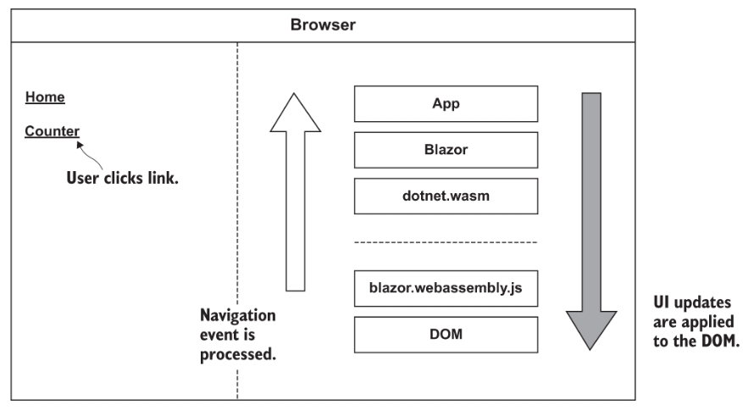
Now , How does UI updates work

Slide 12
For our scenario, we have a Blazor WebAssembly application with two pages containing only a header: Home and Counter, respectively. The user is on the home page of the application and will click the link to go to the Counter page. We’ll follow the process Blazor goes through to update the UI while navigating from the Home page to the Counter page.
When the user clicks on the Counter link, the navigation event is intercepted by Blazor’s JavaScript run time (blazor.webassembly.js). This event is then passed over to the Blazor framework running on the WebAssembly run time (dotnet.wasm) and is processed by Blazor’s router component.
The router checks its routing table for any routable components that match the route the user has attempted to navigate to. In our case, it will find a match with the Counter component, a new instance of that component will be created, and the relevant life cycle methods will be executed.
Once complete, Blazor will work out the minimum number of changes that are required to update the DOM to match that of the Counter component. When this is complete, those changes will be passed back down to the Blazor JavaScript run time, which will then apply those changes to the physical DOM. At this point, the UI will update and the user will be on the Counter page.
All of this has happened client side in the user browser. There was no need for a server during any point in this process

Slide 13
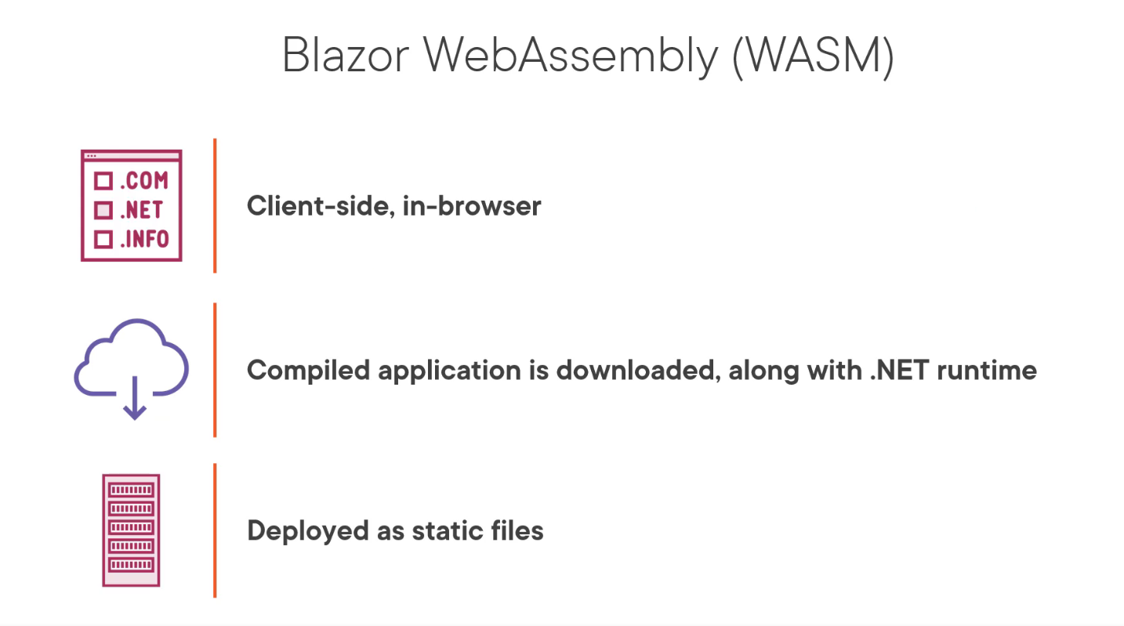

Slide 14
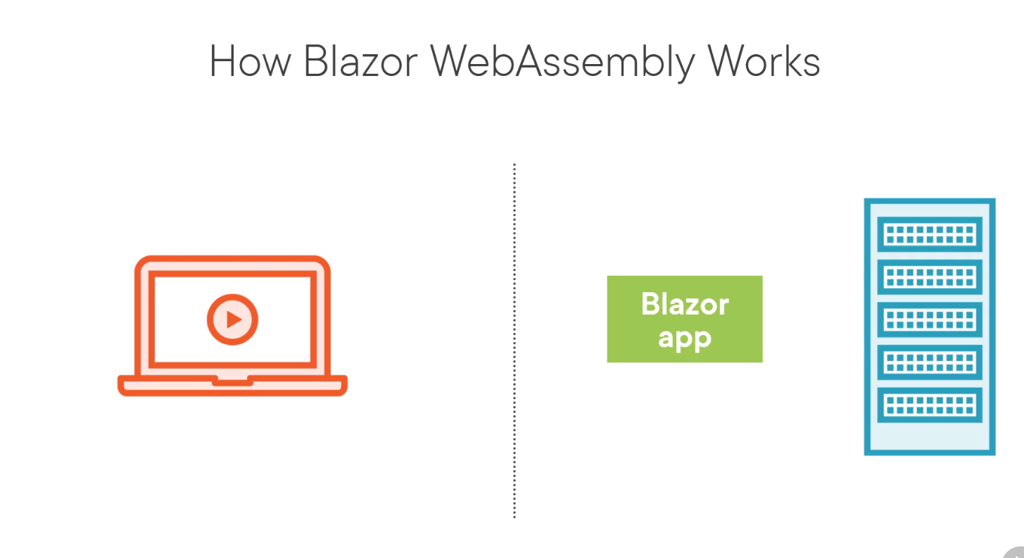

Slide 15
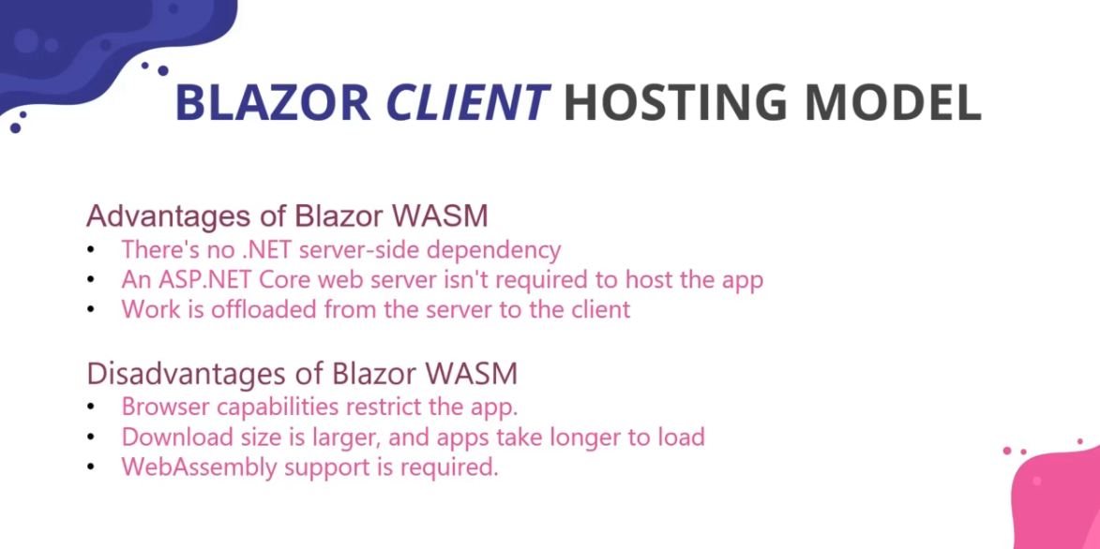

Slide 16
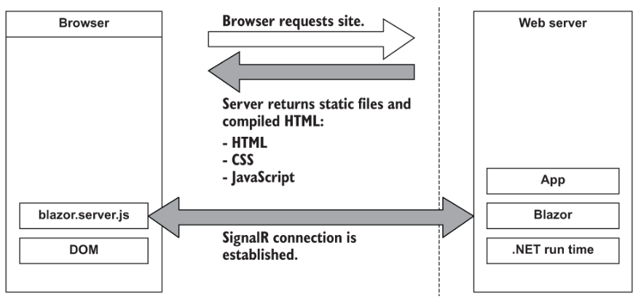
Blazor Server

Slide 17
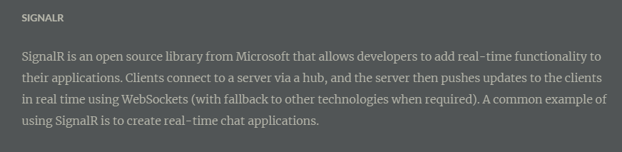
The process begins with a request to load the site from the browser.The request is then processed by the application, and the initial payload is sent back to the browser. This includes static assets such as CSS and JavaScript files and images. There is also the initial HTML, but this is compiled rather than the static HTML we saw in Blazor WebAssembly. This is because the hosting page for a Blazor Server application is a Razor Page rather than a static HTML page in the WebAssembly model. The advantage of this is it allows Blazor Server applications to use server-side prerendering out of the box. In fact, this feature is enabled by default when you create this type of Blazor application.
Once the initial payload is returned to the browser, the files are processed and the DOM is created—then a file called blazor.server.js is executed. The job of this run time is to establish a SignalR connection back to the Blazor application running on the server. At this point, the application is fully booted and ready for user interaction.

Slide 18
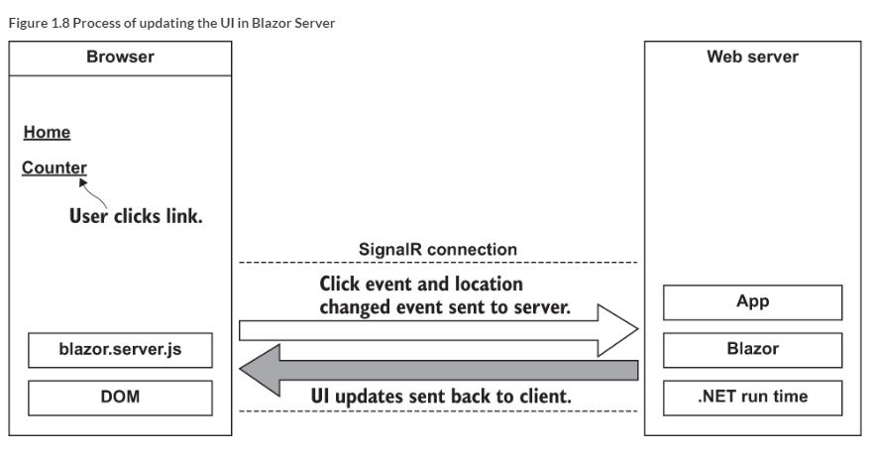
What of Updates

Slide 19
In this case, there are two things—a mouse click event and a navigation event, due to it being a hyperlink that was clicked. These two events are then bundled up and sent back to the server over the SignalR connection that was established when the application started.
On the server, the message sent from the client is unpacked and processed. The Blazor framework then calls any application code necessary. In this case, it would instantiate an instance of the Counter page component and execute the relevant life cycle methods.
Once this process is complete, Blazor will work out the minimum number of changes needed to make the current page transform to the Counter page and then send these back to the client via the SignalR connection. Just to be clear, Blazor will not send back an entirely new page to the client. It will send back only the minimum number of instructions needed to update the current DOM to match the Counter page. In our case, the only difference is the heading. Blazor will send back a single instruction to change the text in the heading from Home to Counter. Nothing else will be changed.
Once back on the client, the changes are unpacked and the required changes are applied to the physical DOM. From the user’s perspective, they appear to have navigated to a new page in the application, the Counter page. But they are still on the same physical page; it just has a different header.

Slide 20
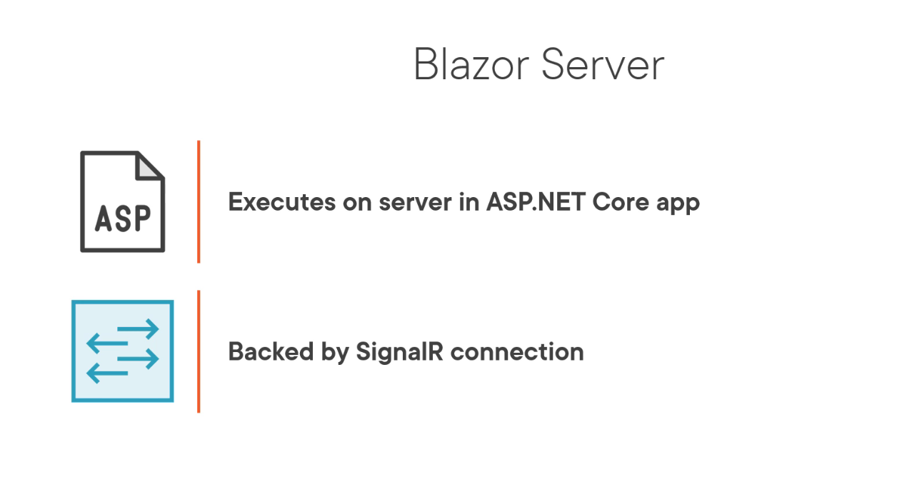

Slide 21
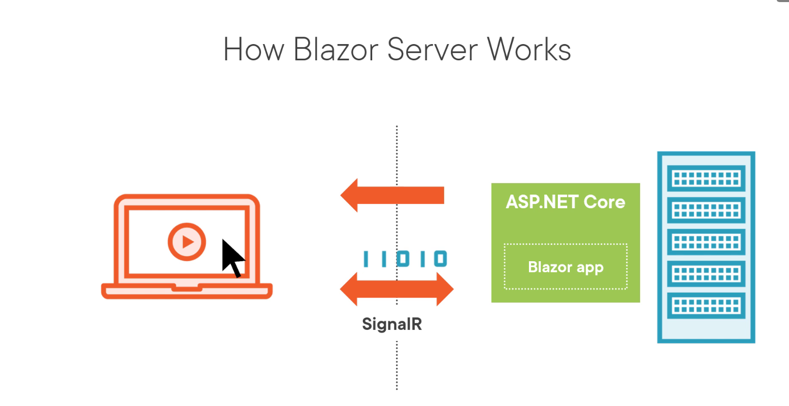

Slide 22
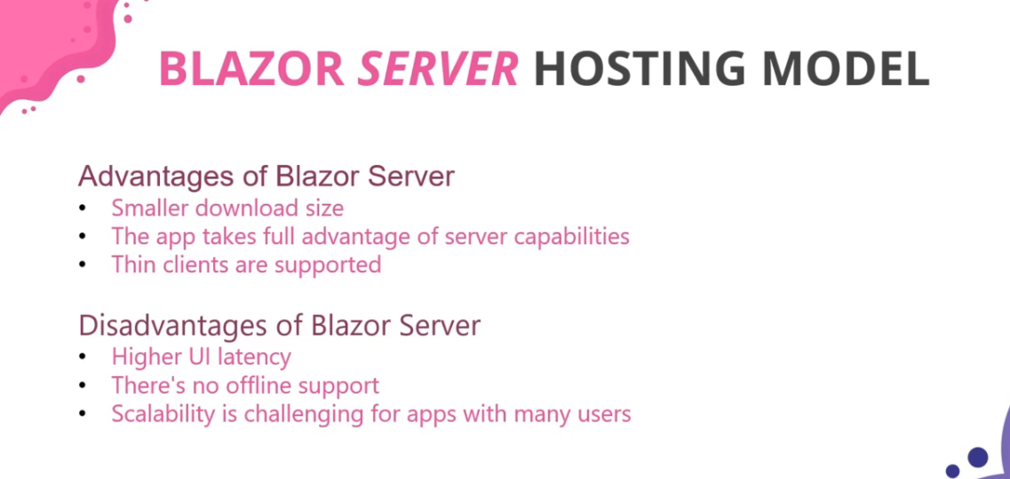

Slide 23
Other Hoisting Models
Blazor Hybrid
Blazor Hybrid is built on technology from the .NET MAUI framework and allows developers to use Blazor to write cross-platform desktop applications. Components are written using C#, HTML, and CSS, just as with Blazor WebAssembly and Blazor Server, and are rendered using a control called BlazorWebView. The following listing shows an example of a component that runs in a Blazor Hybrid application.
Mobile Blazor Bindings
Mobile Blazor Bindings is an experimental hosting model and takes a different approach to authoring components. Components for this hosting model must be written using native controls. The following listing contains the same component as listing 1.1 but is rewritten for the Mobile Blazor Bindings hosting mode

Slide 24
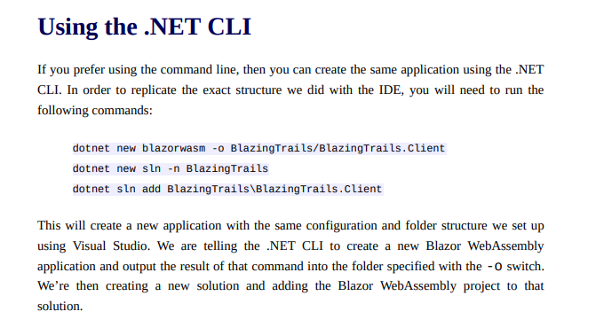
Creating a Blazor App
We can create using the IDE
We can create using the .NET CLI

